Slide 1
Bank of America Marketing Strategy

Slide 2
Agenda
Introduction
Dataset Overview
Data Summary and Structure
Visualization: Purchases histogram
Removing Cust_ID
Customer Segmentation
Clustering Methods
Marketing Strategy recommendations

Slide 3
Introduction about Bank of America
Bank of America (BOA) is one of the largest financial institutions in the United States, offering a wide range of banking and financial services to individuals, businesses, and institutions.
Bank of America's credit card services are a cornerstone of its offerings, providing customers with convenient and flexible payment solutions, rewards programs, and financial management tools.
The credit card services provided by Bank of America are designed to meet the diverse financial needs of its customers, whether they are looking for everyday spending convenience, travel benefits, or financial flexibility.

Slide 4
Dataset Overview
The dataset provides a comprehensive overview of the usage behavior of approximately 9000 active Bank of America (BOA) credit card holders over the last 6 months.
It contains 18 variables that capture various aspects of customer behavior, financial activities, and credit card usage patterns

Slide 5
CUST_ID: Identification of Credit Card holder (Categorical)
BALANCE: Balance amount left in their account to make purchases
BALANCE_FREQUENCY: Frequency of updating balance (0 to 1)
PURCHASES: Number of purchases made from account
ONEOFF_PURCHASES: Maximum purchase amount done in one-go
INSTALLMENTS_PURCHASES: Amount of purchase done in installments
CASH_ADVANCE: Cash in advance given by the user
PURCHASES_FREQUENCY: Frequency of purchases (0 to 1)
ONEOFFPURCHASESFREQUENCY: Frequency of one-off purchases (0 to 1)
PURCHASESINSTALLMENTSFREQUENCY: Frequency of purchases in installments (0 to 1)
CASHADVANCEFREQUENCY: Frequency of cash advances (0 to 1)
CASHADVANCETRX: Number of transactions made with "Cash in Advance"
PURCHASES_TRX: Number of purchase transactions made
CREDIT_LIMIT: Limit of Credit Card for user
PAYMENTS: Amount of Payment done by user
MINIMUM_PAYMENTS: Minimum number of payments made by user
PRCFULLPAYMENT: Percent of full payment paid by user
TENURE: Tenure of credit card service for user

Slide 6
Dataset Summary and Structure
The CUST_ID variable is initially stored as a character (chr) data type in the dataset.
Converting CUST_ID into a factor variable can provide benefits such as efficient
memory usage and improved performance in certain analyses.
By converting CUST_ID to a factor, R treats it as a categorical
variable with distinct levels, which can be useful for categorical data analysis and visualization
Code-
## Reading the Data
Setboa.data <- read.csv("BOA.csv.csv")
##Using Dim, Summary and Str to read the data
dim(boa.data)
summary(boa.data)
str(boa.data)
## Coverting CUST_ID into Factor
boa.data$CUST_ID <- factor(boa.data$CUST_ID)

Slide 7
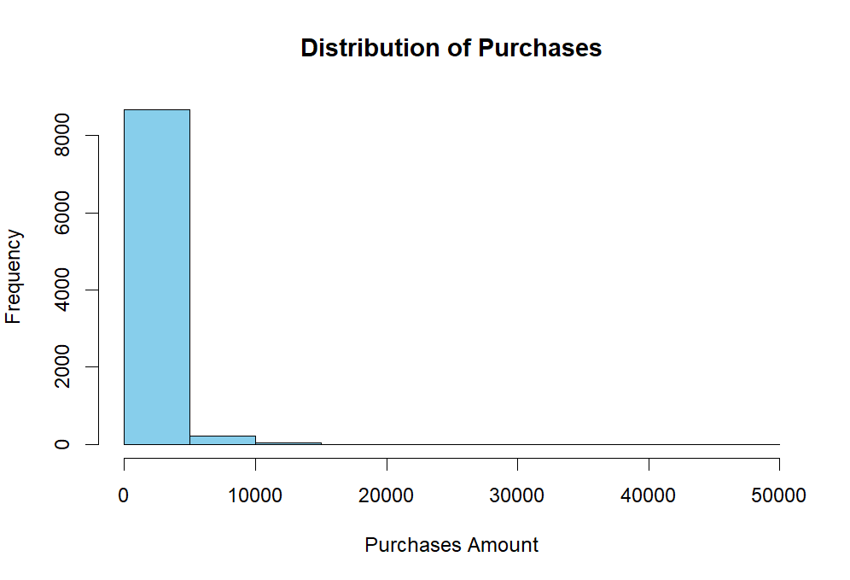
Visualization: Purchases histogram
hist(boa.data$PURCHASES,
col = "skyblue", border = "black", main = "Distribution of Purchases", xlab = "Purchases Amount", ylab = "Frequency")

Slide 8
Removing Cust_Id
By removing CUST_ID from the dataset, we can streamline the analysis process, improve the relevance of the variables
under consideration and focus on extracting meaningful insights related to the usage behavior of BOA credit card holders.
Code-
boa_data <- boa.data[, -2]

Slide 9
Customer Segmentation
Customer segmentation is the process of dividing a customer base into groups or segments that share similar characteristics, behaviors, or needs.
Targeted marketing involves identifying specific customer segments and developing marketing strategies tailored to each segment.
Clustering methods, such as hierarchical clustering (hclust), k-means clustering (kmeans), and model-based clustering (Mclust), are commonly used for customer segmentation.
Clustering methods provide a systematic approach to segmenting customers based on objective criteria, reducing subjectivity in the segmentation process
customer segmentation is a fundamental strategy in targeted marketing, and clustering methods play a crucial role in identifying and understanding distinct customer segments for personalized marketing initiatives.

Slide 10

Clustering Methods

Slide 11
Hclust
Hierarchical clustering is a method used to group similar objects into clusters based on their distance or similarity. It creates a hierarchical tree-like structure known as a dendrogram, where the objects are progressively merged into clusters based on their similarity.
Code- ## Using Library Cluster cause of mixed data types
library(cluster)boa.dist <- daisy(boa_data)
## Clustering Using Hclust
boa.hc<-hclust(boa.dist,method="complete")
boa.hc
## Plottingplot(boa.hc)
plot(cut(as.dendrogram(boa.hc),h=50000)$lower[[1]])

Slide 12
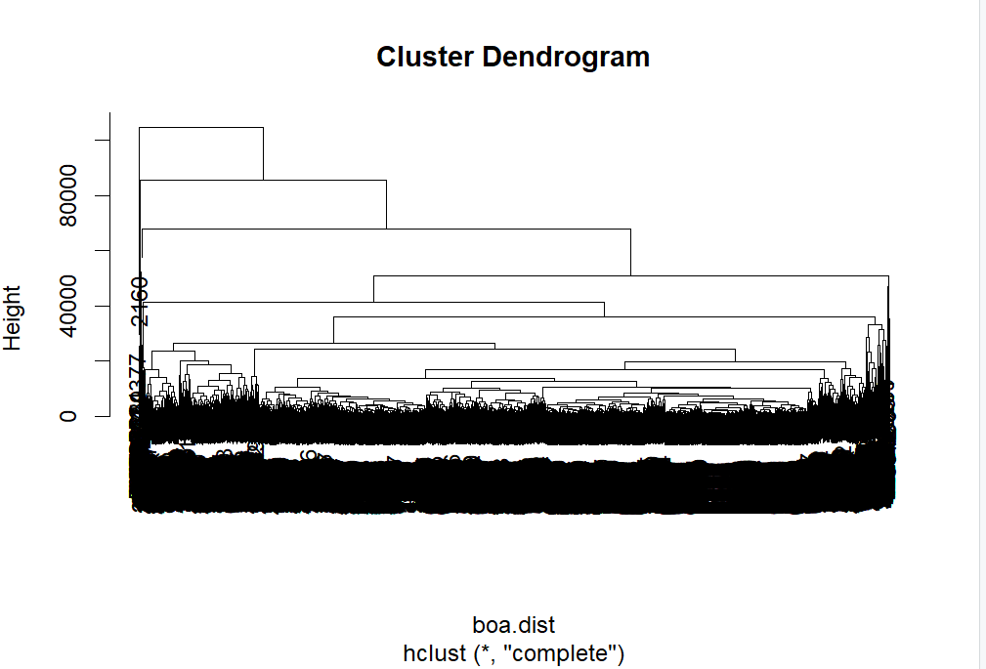
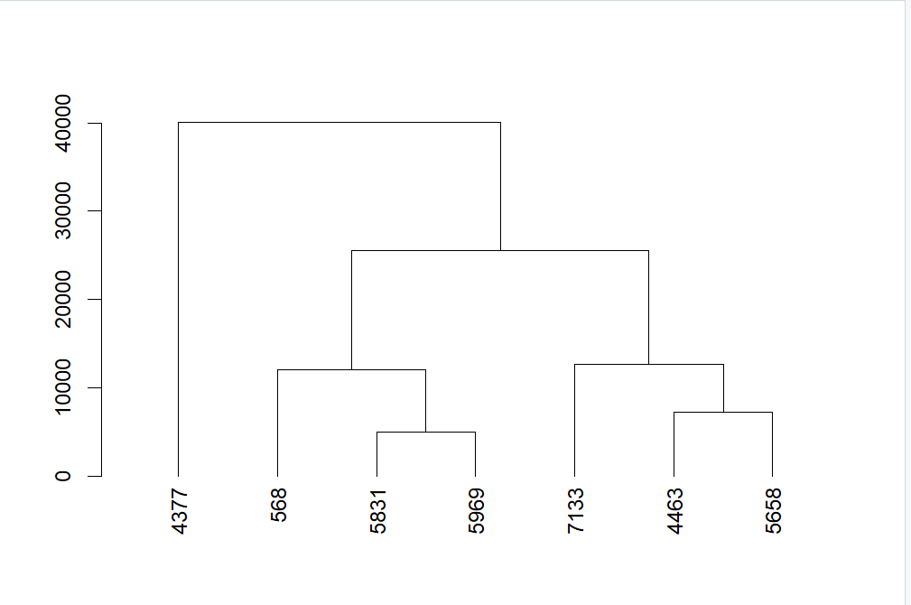

Slide 13
Kmeans
K-means clustering is a popular unsupervised machine learning algorithm used for partitioning a dataset into a predetermined number of clusters (K).The algorithm aims to group data points into K clusters, where each point belongs to the cluster with the nearest mean (centroid).
Code- set.seed(17260)
boa_kmeans <- kmeans(boa_data, centers = 4)
boa.summ<-function(data,groups){ aggregate(data,list(groups),function(x)mean(as.numeric(x)))}
boa.summ(boa_data,boa_kmeans$cluster)
## Plotting the datal
ibrary(cluster)
clusplot(boa_data, boa_kmeans$cluster, color = TRUE, shade = TRUE, labels = 5, main = "K-means Cluster Plot")

Slide 14
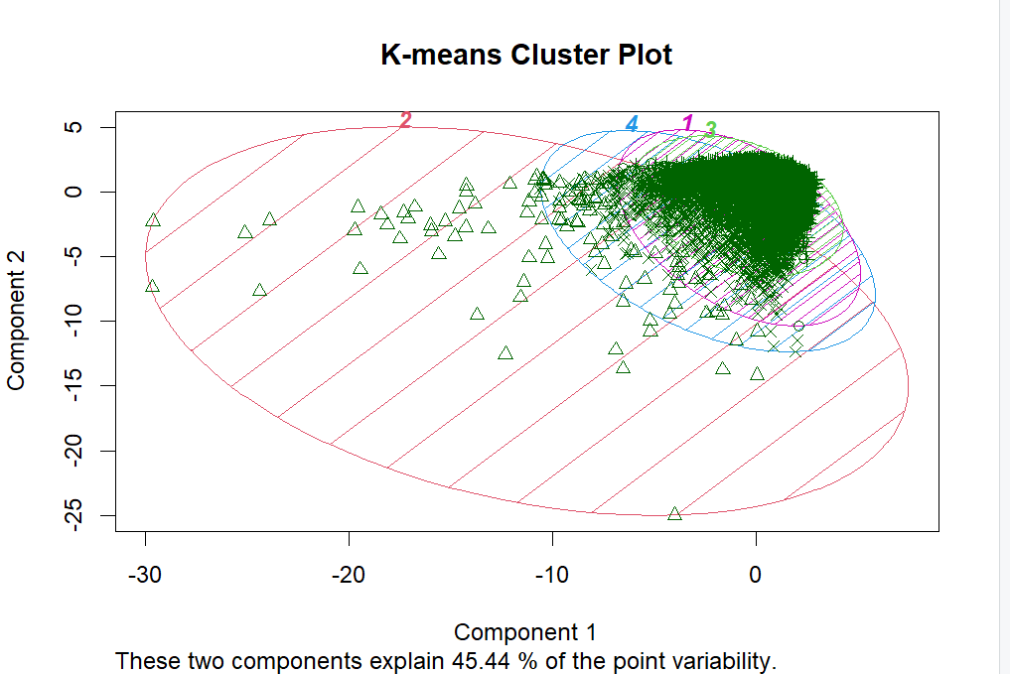

Slide 15
Mclust
It utilizes finite mixture models to represent the data distribution as a combination of several underlying probability distributions. Mclust assumes that the observed data are generated from a mixture of Gaussian (normal) distributions with varying means, variances, and mixing proportions. Each cluster in the dataset is represented by a Gaussian component in the mixture model.

Slide 16
Mclust
Code-
library(mclust)
boa.data.new <- boa.data
boa.mc<-Mclust(boa.data.new)
#use all defaultssummary(boa.mc)
#Mclust for 4 groups
boa.data5<-Mclust(boa.data.new,G=4) summary(boa.data5)
BIC(boa.mc,boa.data5)
boa.summ(boa_data,boa.mc$class)
##plot for Mclust model
clusplot(boa_data,boa.mc$class,color = TRUE,shade = TRUE,labels = 4, main = "Model-based cluster plt")
##plot for Mclust model for 4 labels
clusplot(boa_data,boa.data5$class,color = TRUE,shade = TRUE,labels = 4, main = "Model-based cluster plt")

Slide 17
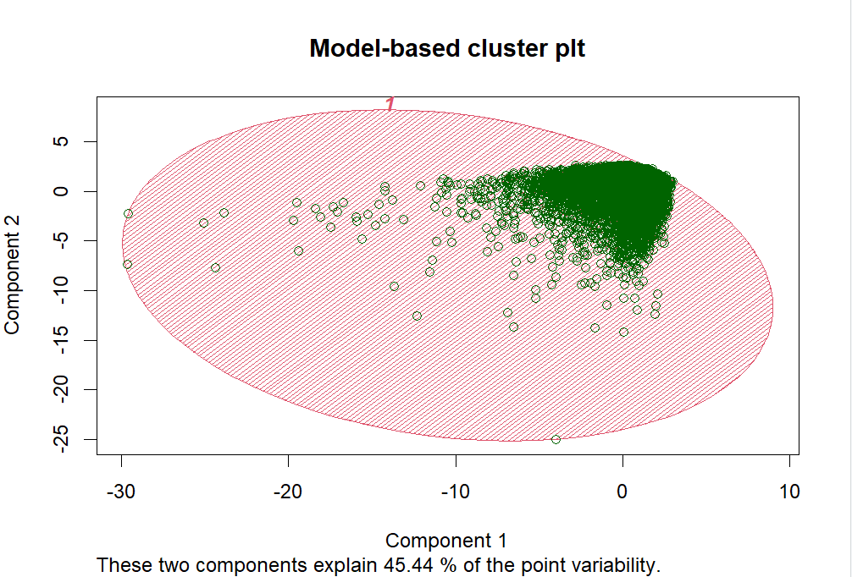
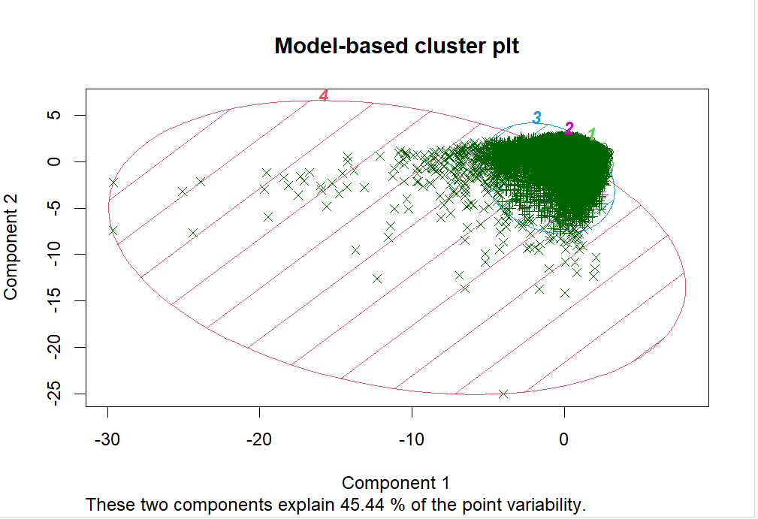

Slide 18
Marketing Strategy recommendations

Slide 19
Marketing Strategy recommendations
Segment-specific Offers
Personalized Communication
Loyalty Programs
Financial Education Resources
Cross-selling Opportunities
Customer Feedback Mechanisms
Retention Strategies

Slide 20

Questions?

Slide 21
Thank you
Miloni
Mehraein
Shreya Motay

